Slide 1

For Beginners!
Lipi Gupta
July 31, 2020
Some materials sourced from Eric Krause and Ron Bannon

Slide 2
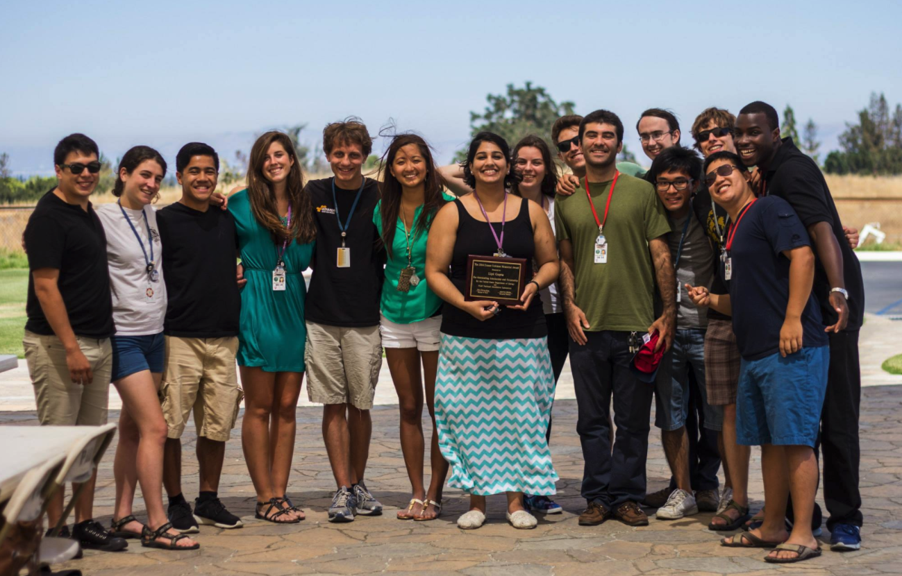
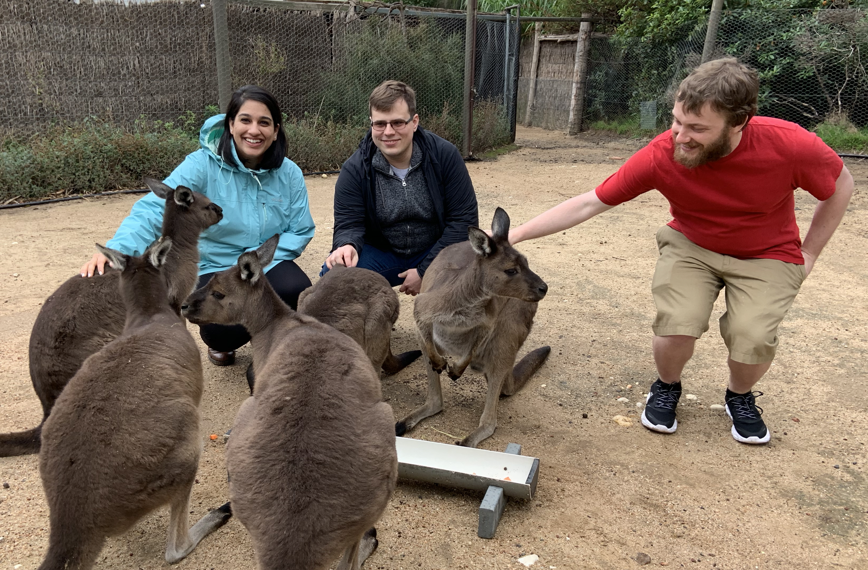
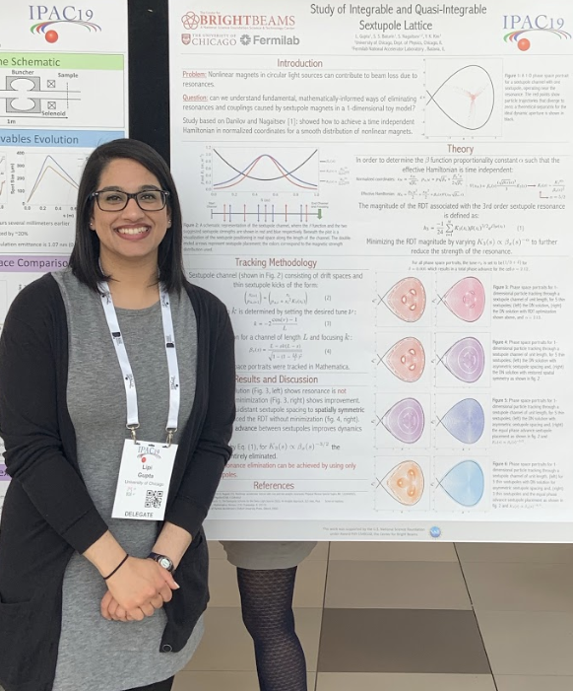
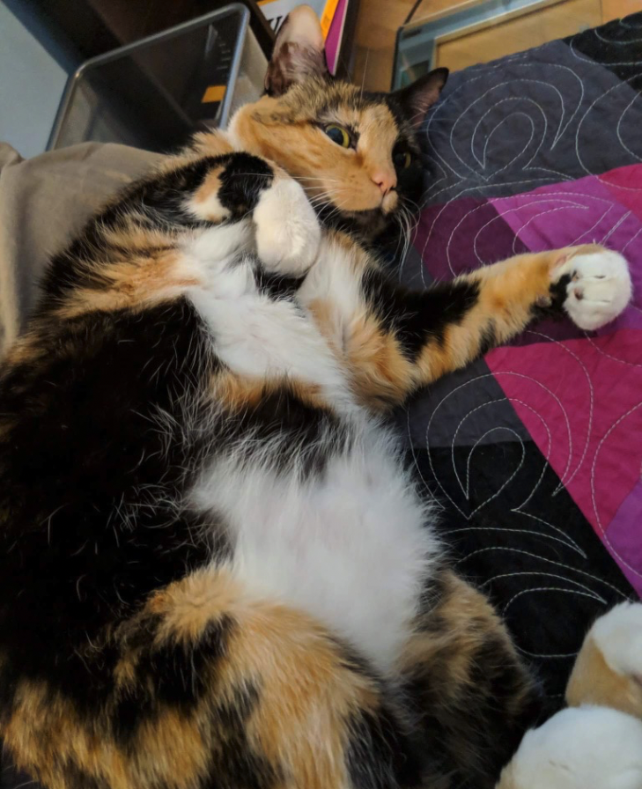


About Lipi
5th year PhD Student at University of Chicago
BA in Physics from Cornell University (2015)
from Oregon
SULI Alum
https://www.linkedin.com/in/lipigupta/

Slide 3

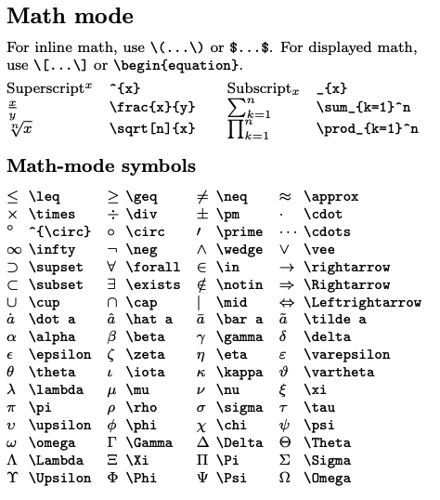
Pronounced “lay-tech” or “la-tech”(does not rhyme with “paychecks”!)
Document preparation tool:
Quick Formatting (and re-formatting)
Easy equations and symbols typesetting
Sophisticated figure management and tables creation
Advantages:
FREE!
Used in most academic and professional settings
Creative freedom
https://wch.github.io/latexsheet/

Slide 4


How to Install
All distributions:
https://www.latex-project.org/get/#tex-distributions
Recommended:
Have a university email address? Use it!

Slide 5

Resources!
https://tobi.oetiker.ch/lshort/lshort.pdf
Exercises available here!
http://m11.mathography.org/
Some other useful websites!
https://wch.github.io/latexsheet/
https://www.tablesgenerator.com/
https://www.latex-tutorial.com/tutorials/

Slide 6

A First Look at
1
2
3
4
5
6
7
8
9
10
11
12
13
14
15
\documentclass[a4paper]{article}
\usepackage{amsmath}
\title{My First \LaTeX}
\author{Lipi Gupta}
\date{\today}
\begin{document}
\maketitle
% This is a comment!
\section{Introduction}
Hello, there! This is my paper.
\end{document}
Compiler
firstlatex.tex
firstlatex.pdf

Slide 7
Deciphering the “code”
Optional
Argument
1
\documentclass[a4paper]{article}
Function call
Function argument
Familiar with python?
import latex as lx
lx.documentclass(article, paper_type = a4paper)
* this is a made-up line of code to make LaTeX seem familiar!

Slide 8
Deciphering the “code”
Optional
Argument
1
\documentclass[a4paper]{article}
Function call
Function argument
Some functions with arguments:
Some functions without arguments:
\textit{some words}
\today
\Sum
\section{some words}
\alpha
\frac{x}{y}
\chi
\neq

Slide 9

What are environments?
1
2
3
4
5
6
7
8
9
10
11
12
13
14
15
\documentclass[a4paper]{article}
\title{My First \LaTeX}
\author{Lipi Gupta}
\date{\today}
\begin{document}
My Grocery list:
\begin{enumerate}
\item apples
\item coffee
\item milk
\end{enumerate}
\end{document}

Slide 10
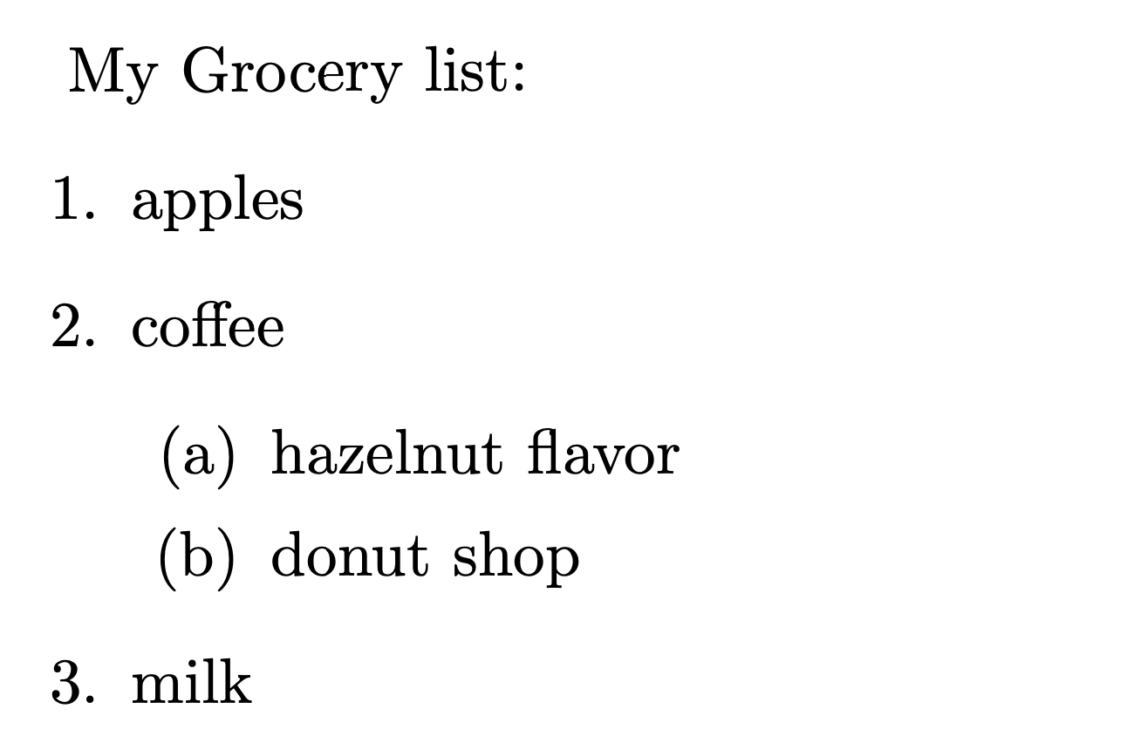
List Environments
1
2
3
4
5
6
7
8
9
10
11
12
13
14
15
16
17
18
\documentclass[a4paper]{article}
\title{My First \LaTeX}
\author{Lipi Gupta}
\date{\today}
\begin{document}
My Grocery list:
\begin{enumerate}
\item apples
\item coffee
\begin{enumerate}
\item hazelnut flavor
\item donut shop
\end{enumerate}
\item milk
\end{enumerate}
\end{document}
https://www.latex-tutorial.com/tutorials/lists/

Slide 11
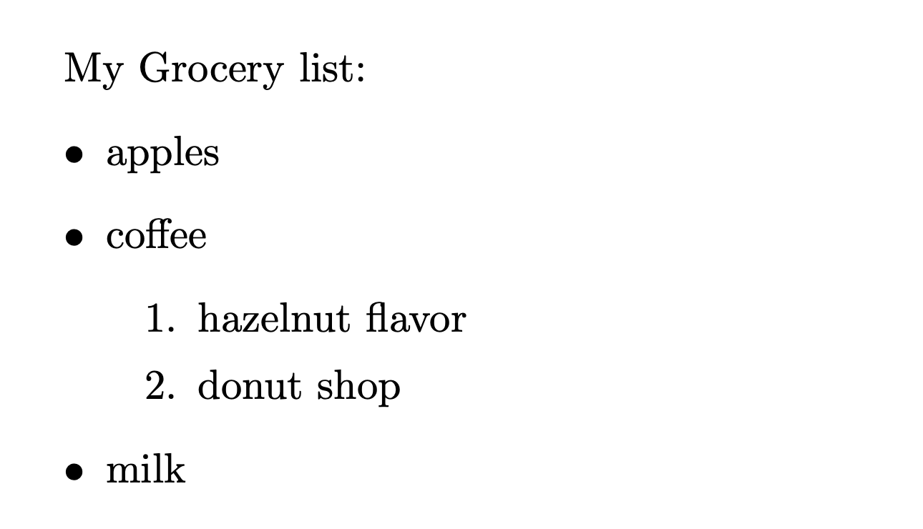
List Environments
1
2
3
4
5
6
7
8
9
10
11
12
13
14
15
16
17
18
\documentclass[a4paper]{article}
\title{My First \LaTeX}
\author{Lipi Gupta}
\date{\today}
\begin{document}
My Grocery list:
\begin{itemize}
\item apples
\item coffee
\begin{enumerate}
\item hazelnut flavor
\item donut shop
\end{enumerate}
\item milk
\end{itemize}
\end{document}
https://www.latex-tutorial.com/tutorials/lists/

Slide 12
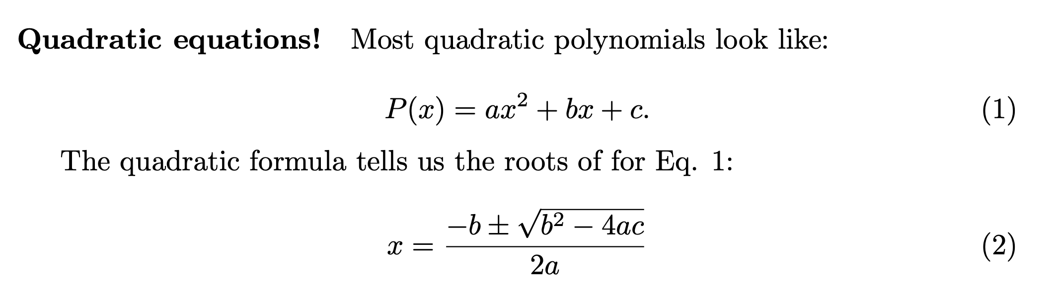
Math Mode!
1
2
3
4
5
6
7
8
9
10
11
12
13
14
15
16
17
18
19
\begin{document}
\paragraph{Quadratic equations!}
Most quadratic polynomials look like:
\begin{equation}
P(x) = a x^2 + b x + c.
\label{eq:quadratic}
\end{equation}
The quadratic formula tells us the roots of for Eq. \ref{eq:quadratic}:
\begin{equation}
x = \frac{-b \pm \sqrt{b^2 - 4ac}}{2a}
\end{equation}
\end{document}

Slide 13
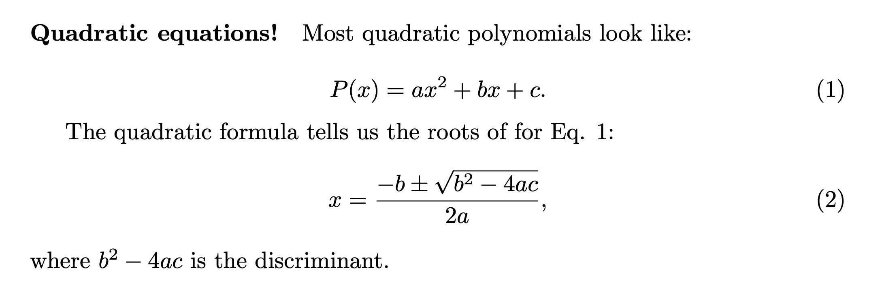
Math Mode!
1
2
3
4
5
6
7
8
9
10
11
12
13
14
15
16
17
18
19
20
21
\begin{document}
\paragraph{Quadratic equations!}
Most quadratic polynomials look like:
\begin{equation}
P(x) = a x^2 + b x + c.
\label{eq:quadratic}
\end{equation}
The quadratic formula tells us the roots of for Eq. \ref{eq:quadratic}:
\begin{equation}
x = \frac{-b \pm \sqrt{b^2 - 4ac}}{2a}
\end{equation}
where $b^2 - 4ac$ is the discriminant.
\end{document}

Slide 14
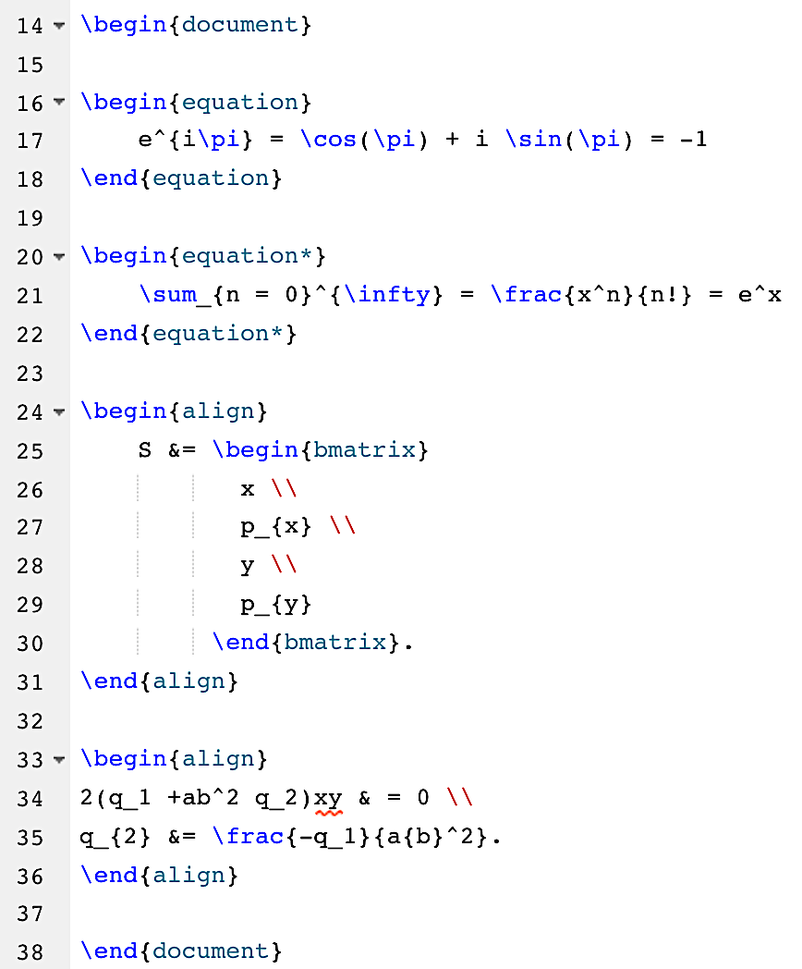
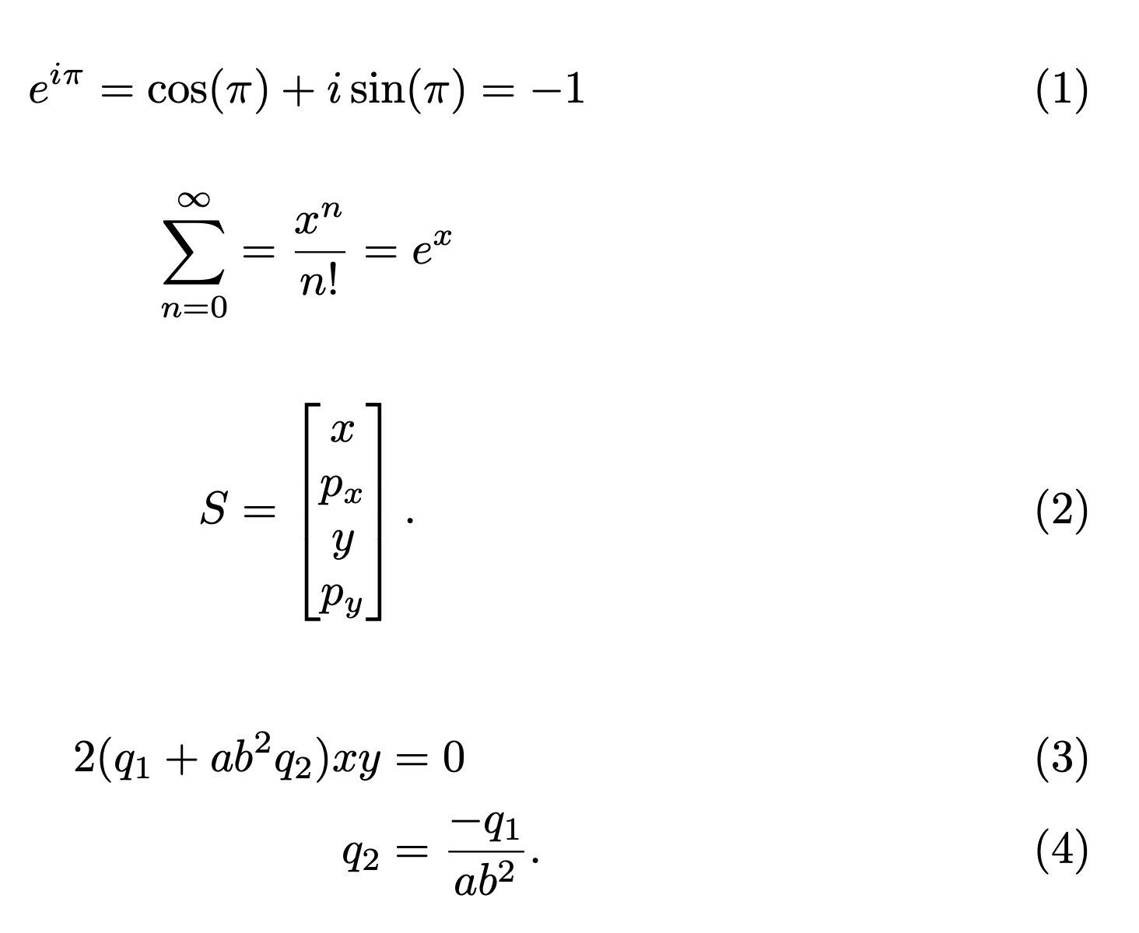
Some fancier stuff….

Slide 15
Tables!
https://www.latex-tutorial.com/tutorials/tables/
Instructions about where the table should be placed**
1
2
3
4
5
6
7
8
9
10
11
12
\begin{document}
\begin{table}[]
\centering
\begin{tabular}{cc}
Parameter & Value \\
\hline
a & 500 \textrm{m}\\
b & 100 \textrm{s}\\
\end{tabular}
\end{table}
\end{document}
How many columns and how are those elements justified within the column?
ccclll
(6 columns, first 3 are centered, last three are left-justified)
Line break
** see section 2.13 Floating Bodies
in Oetiker et. al.

Slide 16

Tables!
https://www.latex-tutorial.com/tutorials/tables/
1
2
3
4
5
6
7
8
9
10
11
12
13
14
15
16
17
18
\begin{document}
\begin{table}[]
\caption{This is my first table!}
\begin{tabular}{cc}
Parameter & Value \\
\hline
a & 500 \textrm{m}\\
b & 100 \textrm{s}\\
\end{tabular}
\label{tab:first}
\end{table}
Please refer to table \ref{tab:first}
\end{document}
https://www.tablesgenerator.com/

Slide 17
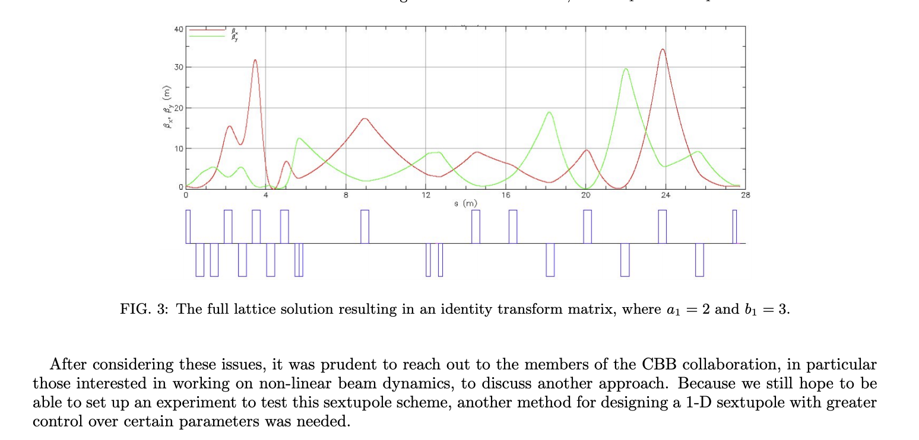
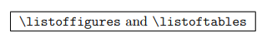
Figures!
1
2
3
4
5
6
7
8
9
10
\usepackage{graphicx}
\begin{figure}[h!]
\centering
\includegraphics[width = 0.7\textwidth]{mypicture.jpg}
\caption{The full lattice solution resulting in an identity transform matrix, where $a_1 = 2$ and $b_1 = 3$.}
\label{fig:pic}
\end{figure}
Reminder: the file name should be a path to the image. Think about how to keep this organized!

